Slide 1
WET – Water Efficiency tooL
Bessis Hugo, Saouab Oumniya,
Utama Takara Izzah, van der Heide Niklas

Slide 2
Table of contents
Introduction
Solution
Problems and Lessons learned
Demo
Questions

Slide 3
Introduction
Home Water Consumption Management App
Give overview over appliances
Manage home appliances
Help people live more sustainable

Slide 4





Solution
Tools
Flutter App (cross platform)
Firebase Authentication
MongoDB database
Node.js API
AWS hosting

Slide 5
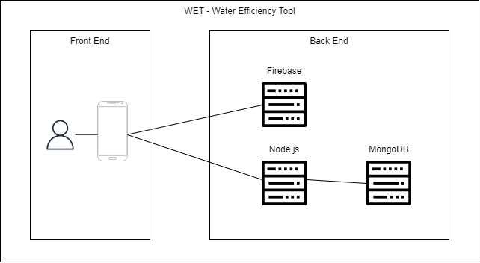
Architecture

Slide 6
Problems and Lessons learned
Problems
Incompatible Schedules
Communication
Team Structure
Integration Hell
Lessons learned
How to use new tools
Working with multiple people

Slide 7
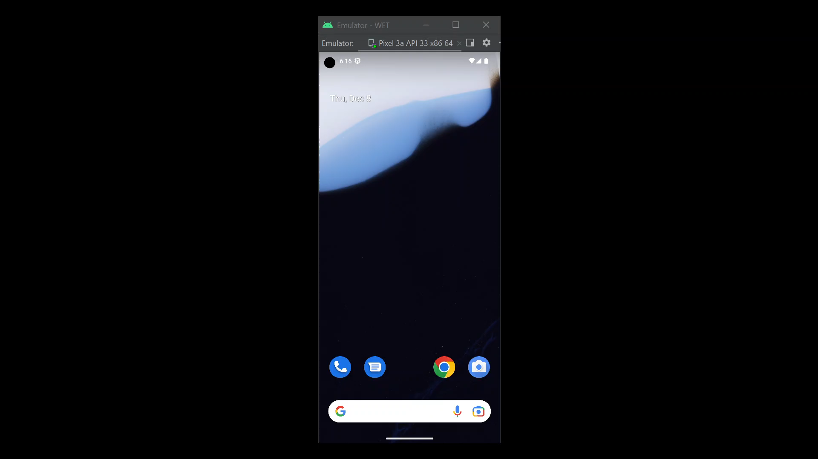
Demo time

Slide 8
Question time
Any Questions?

